Slide 1
Poor man’s task queues on AWS with Shoryuken!
Janusz Mordarski <janusz@mordarski.eu>

Slide 2
Agenda
Task queues
Amazon Web Services SNS, SQS and Shoryuken

Slide 3


Slide 4
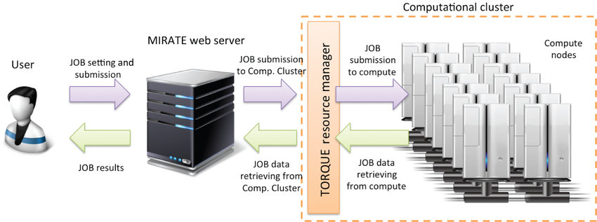
NASA Portable Batch System
“In the past, computers were used in a completely interactive manner. Background jobs were just processes with their input disconnected from the terminal. As the number of processors in computers continued to increase, however, the need to be able to schedule tasks based on available resources rose in importance.” (1986)

Slide 5
Types of task queues
Notes:
5 min

Slide 6
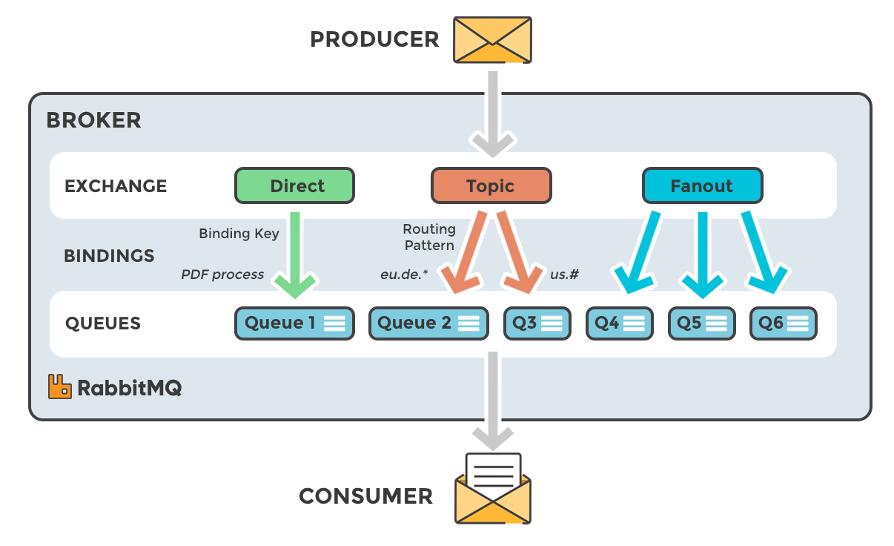
Message Bus
“Messaging infrastructure to allow different systems to communicate.”
📂 📂 📂 📂 📂 📂 📂 📂 📂 📂 📂 📂
Broker
Queues
Producers vs Consumers
Notes:
A message bus is like a big desk with multiple organisers, piles of documents. People or programs can put documents into slots, while others “consume” (take) them for processing. https://www.cloudamqp.com/blog/2015-05-18-part1-rabbitmq-for-beginners-what-is-rabbitmq.html
Technically It’s a combination of a:
1) data store (desk with file organizers), like Redis, where each message can be represented by a key-value record
2) message broker, exchange, queue - a bunch of programs that distribute messages onto queues where they can be “consumed” by other programs. https://www.rabbitmq.com/tutorials/tutorial-two-python.html

Slide 7

Synchronous communication
Interactive tasks
Blocks the line, caller and callee.
Notes:
Imagine this: you’re sitting at your desk, someone calls you and asks to check something.
In the meantime, your colleague asks you another question.
You can’t reply because you’re on the line with someone else. Also, you can’t accept incoming calls.
On the plus side, you can do the work immediately, and both you and the caller know exactly when the work was done and what results were delivered.

Slide 8

Asynchronous communication
Background jobs, like sending mail.
Doesn’t have immediate effect.
Notes:
Same person, same desk, but this time no phone. Instead, there’s a desk file organiser with two slots: IN, OUT. People who want something bring tasks on paper sheets and put them in the IN slot. You, whenever you have free time, take another task from the stack and work on it.
After doing it, put it on the second pile and repeat the action.
Every now and then a person comes who takes everything from the OUT stack and distributes the results to the right people (based on the fact that they “subscribed” to get results).
Depending on the results, some people may come back and ask you to do the task again (this is an example when something failed to be done the first time, e.g. important information was missing).

Slide 9
Task queues for Ruby
Universal:
DelayedJob (SQL database)
Resque (Redis)
Sidekiq (Redis)
Beetle (RabbitMQ AMQP) https://github.com/xing/beetle
Karafka (Kafka)
Amazon Web Services:
Shoryuken (SQS) https://github.com/ruby-shoryuken/shoryuken
ActiveElasticJob (SQS) https://github.com/active-elastic-job/active-elastic-job

Slide 10
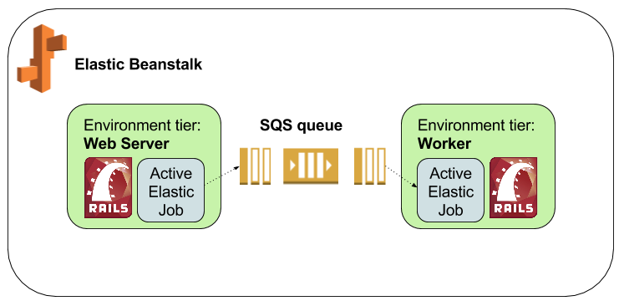
Active Elastic Job

Slide 11
Internal vs Foreign messages
Internal: producer and consumer are the same app
(e.g. MyJob.perform_later(arguments))
Foreign: processing tasks from anywhere
(e.g. AWS S3 notification about a file upload)
“Unfortunately, no one can be told what the ^^^ is. You have to see it for yourself.”

Slide 12
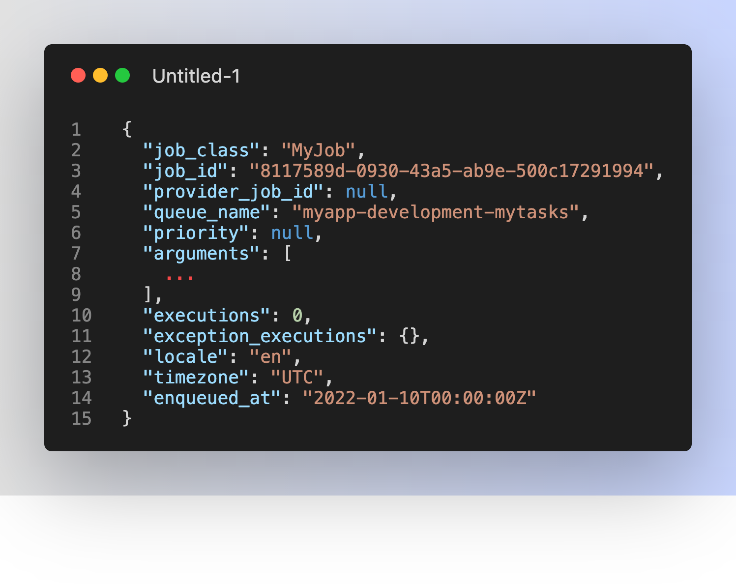

Slide 13
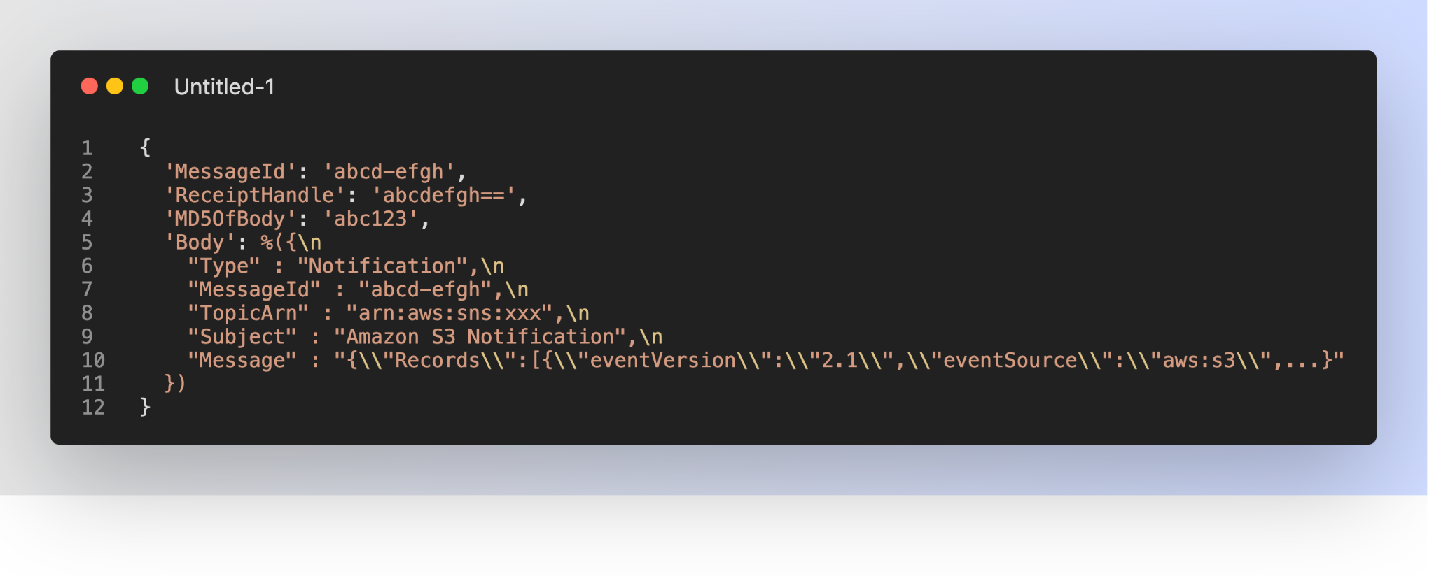

Slide 14
Implementation on AWS with Shoryuken
Notes:
15 min

Slide 15
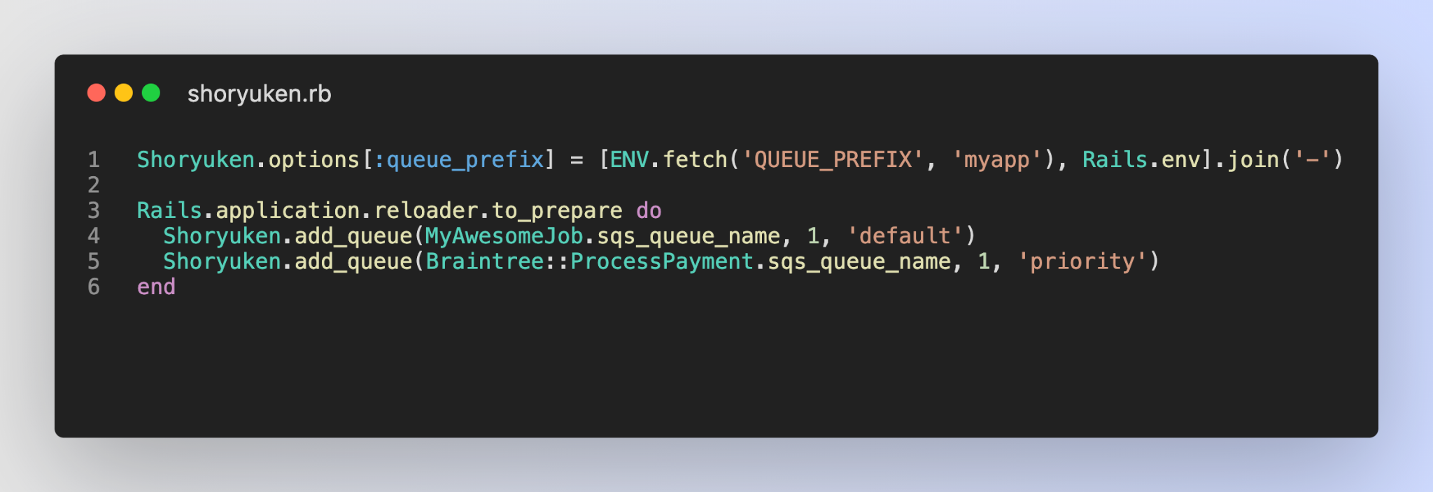
Notes:
With synchronous communication, whatever result you’re requesting from the app is returned in real-time vs. with async it’s returned with a delay, which is what a “subscription” is for

Slide 16
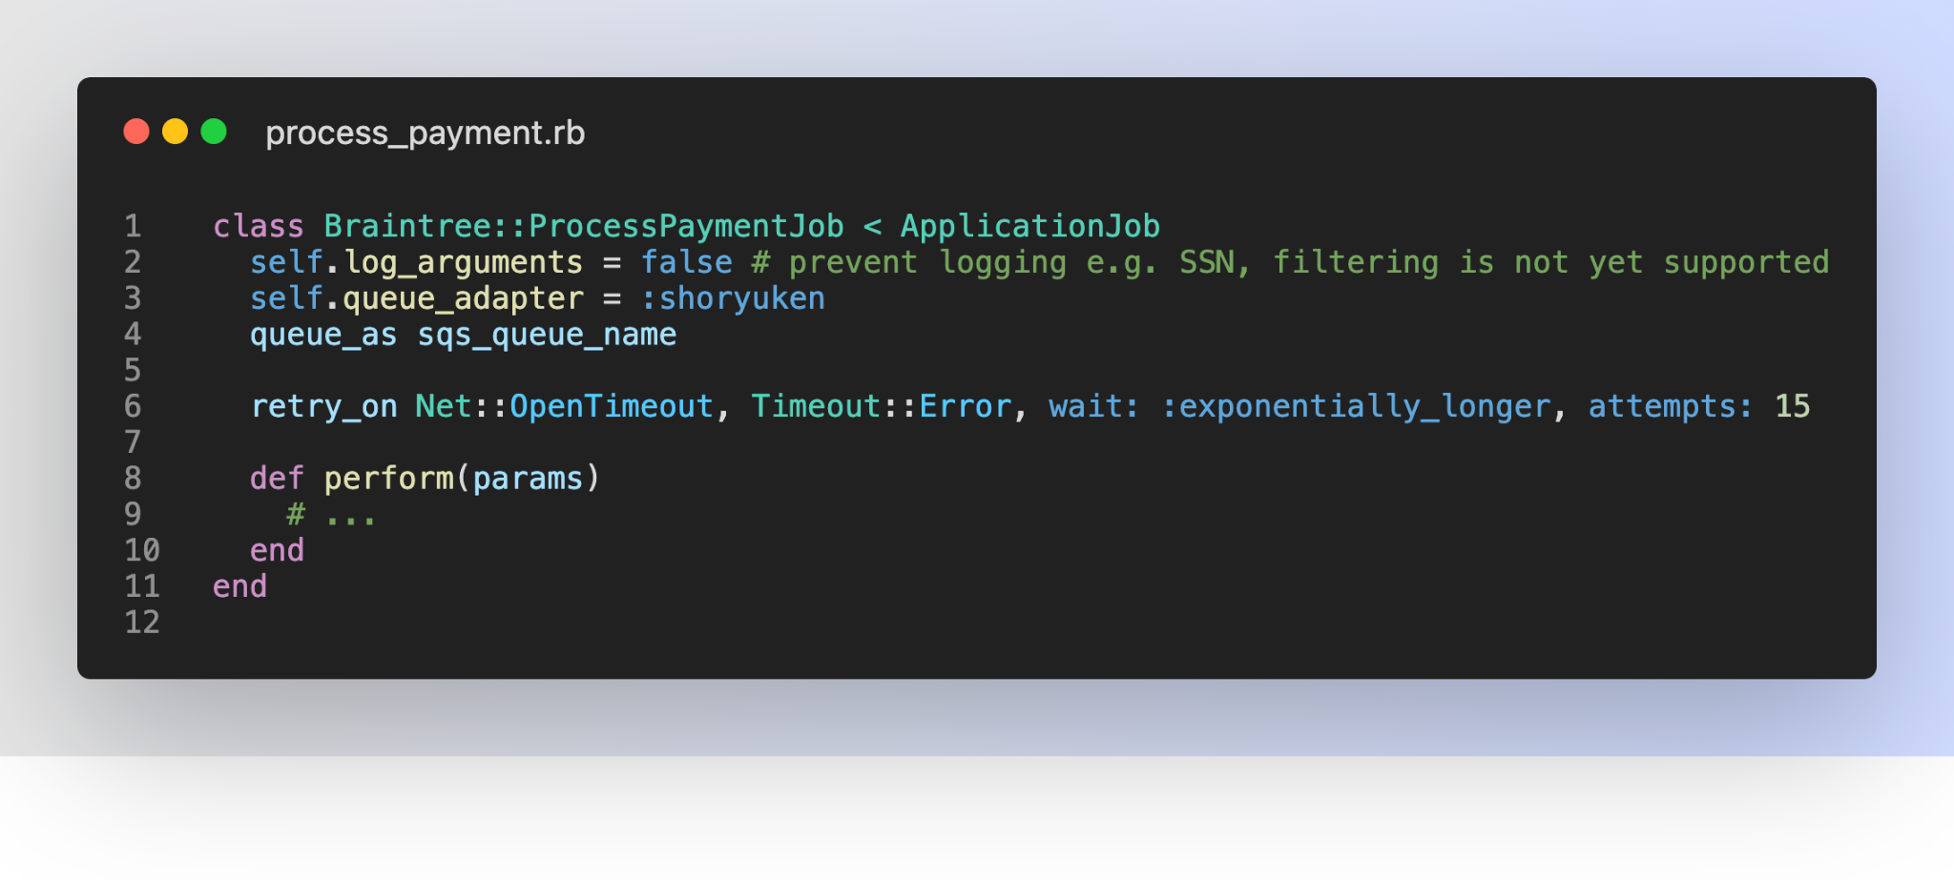

Slide 17
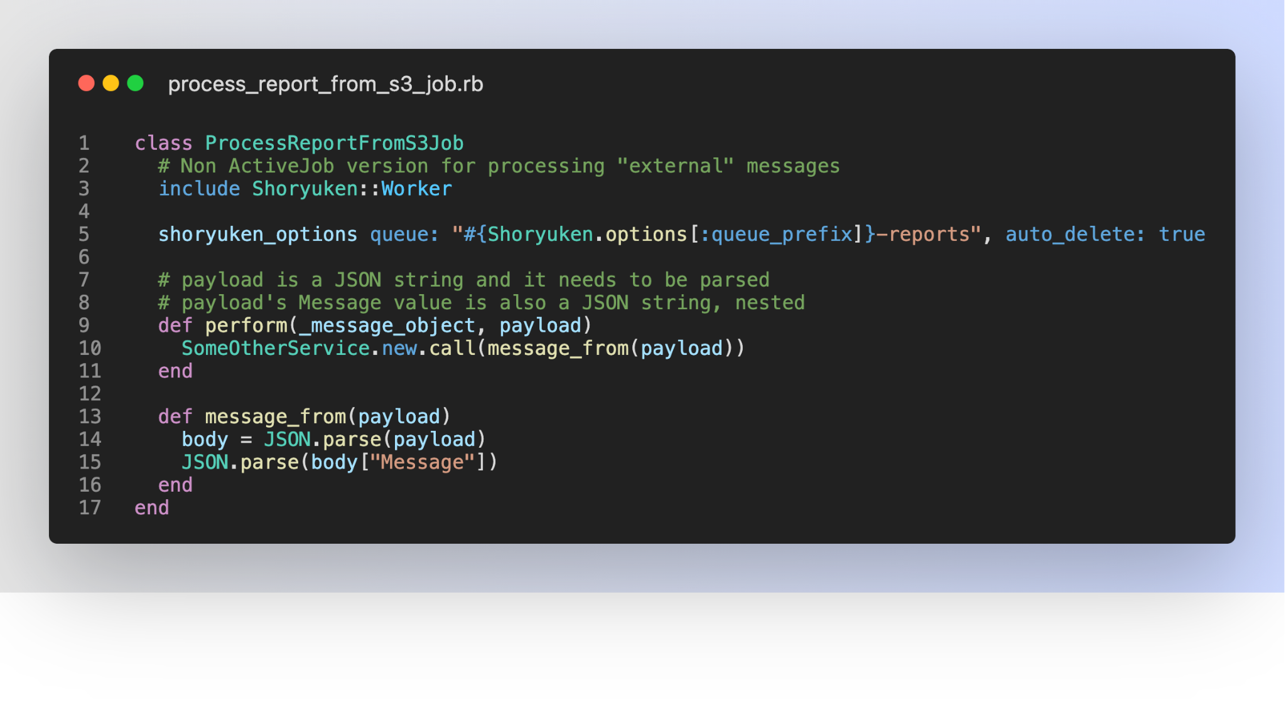

Slide 18
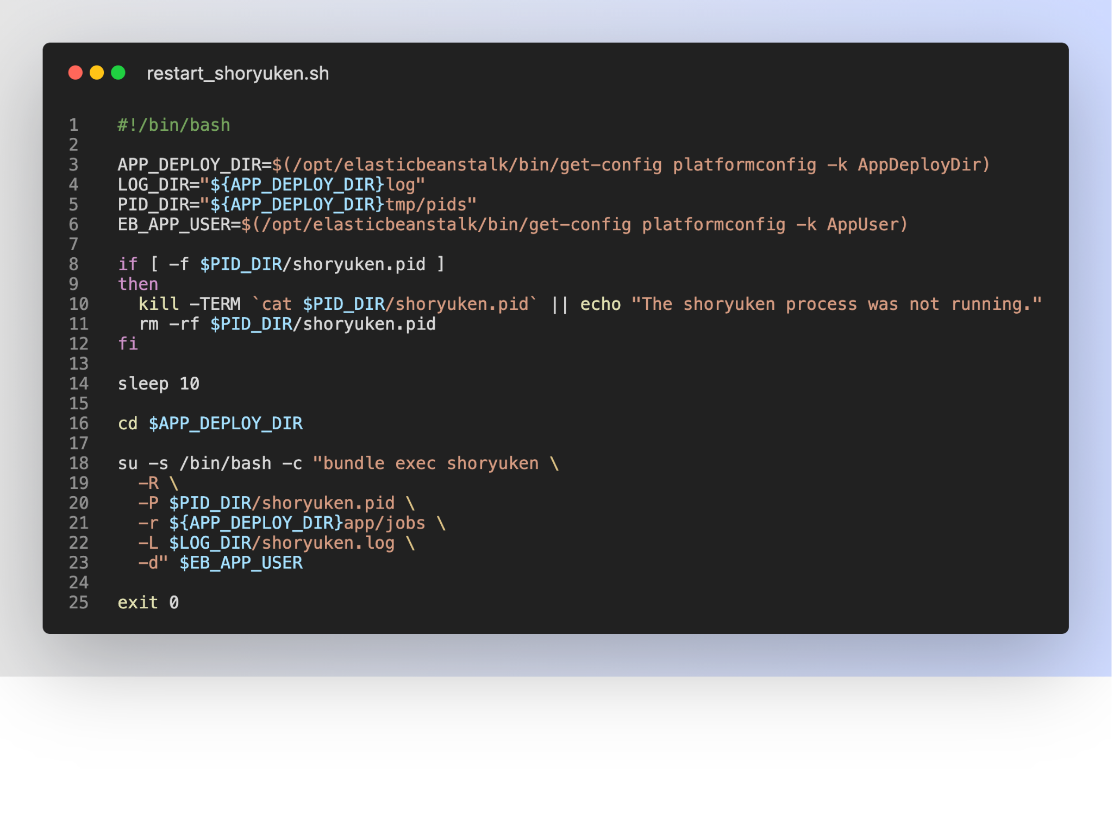

Slide 19
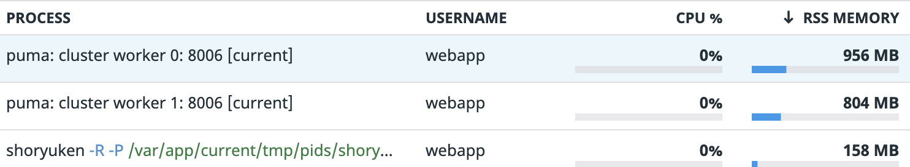

Slide 20





web server
SQS
SNS

Slide 21
Thank you!
Janusz Mordarski
janusz@mordarski.eu
https://github.com/januszm
https://www.linkedin.com/in/janusz-mordarski/
https://www.xing.com/profile/Janusz_Mordarski/cv
http://mordarski.eu

